Slide 1
SQL: Basic Queries
Reference: https://www.w3schools.com/sql/

Slide 2
Simple Select SQL Statement
Pengenalan Query

Slide 3
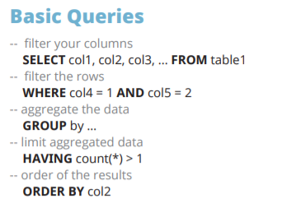
PILIH KOLOM
PILIH ROW
AGREGASI

Slide 4
Anatomi SELECT Statement
SELECT EMPLOYEE_ID, FIRST_NAME, HIRE_DATE, JOB_ID, SALARY
FROM EMPLOYEES
WHERE SALARY > 10000;
Clause
Search Condition
Statement

Slide 5
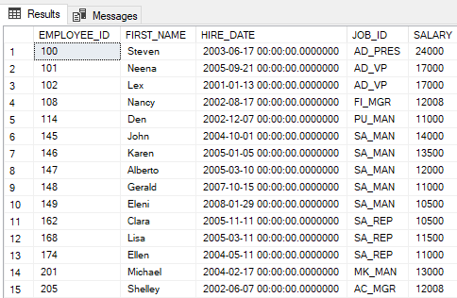
Anatomi SELECT Statement – Fungsi/Kegunaan
Kolom/field yang akan ditampilkan
SELECT EMPLOYEE_ID, FIRST_NAME, HIRE_DATE, JOB_ID, SALARY
FROM HR.EMPLOYEES
WHERE SALARY > 10000;
Tabel yang digunakan
Row yang akan diambil adalah row dengan gaji di atas 10.000
(kriteria pemeriksaan)

Slide 6
Writing SQL Statements
  SQL statements are not case-sensitive.
  SQL statements can be entered on one or more lines.
  Keywords cannot be abbreviated or split across lines.
  Clauses are usually placed on separate lines.
  Indents are used to enhance readability.
  In SQL Developer, SQL statements can optionally be terminated by a semicolon (;). Semicolons are required when you execute multiple SQL statements.
Notes:
Writing SQL Statements
By using the following simple rules and guidelines, you can construct valid statements that are both easy to read and edit:
SQL statements are not case-sensitive (unless indicated).
SQL statements can be entered on one or many lines.
Keywords cannot be split across lines or abbreviated.
Clauses are usually placed on separate lines for readability and ease of editing.
Indents should be used to make code more readable.
Keywords typically are entered in uppercase; all other words, such as table names and columns names are entered in lowercase.
Executing SQL Statements
In SQL Developer, click the Run Script icon or press [F5] to run the command or commands in the SQL Worksheet. You can also click the Execute Statement icon or press [F9] to run a SQL statement in the SQL Worksheet. The Execute Statement icon executes the statement at the mouse pointer in the Enter SQL Statement box while the Run Script icon executes all the statements in the Enter SQL Statement box. The Execute Statement icon displays the output of the query on the Results tabbed page while the Run Script icon emulates the SQL*Plus display and shows the output on the Script Output tabbed page.
In SQL*Plus, terminate the SQL statement with a semicolon, and then press [Enter] to run the command.

Slide 7
SQL Query Order of Execution
JOIN + FROM
Chose and join tables to get data
WHERE
Filter the data
GROUP BY
Aggregate the base data
HAVING
Filter the aggregated data
SELECT
Returns final data
ORDER BY
Sorts the final data
TOP
Limit the returned data to a row count

Slide 8
Basic SELECT Statement
SELECT *|{[DISTINCT] column|expression [alias],...}
FROM table;
  SELECT identifies the columns to be displayed.
  FROM identifies the table containing those columns.
Notes:
Basic SELECT Statement
In its simplest form, a SELECT statement must include the following:
A SELECT clause, which specifies the columns to be displayed
A FROM clause, which identifies the table containing the columns that are listed in the SELECT clause
In the syntax:
SELECT is a list of one or more columns
* selects all columns
DISTINCT suppresses duplicates
column|expression selects the named column or the expression
alias gives the selected columns different headings
FROM table specifies the table containing the columns
Note: Throughout this course, the words keyword, clause, and statement are used as follows:
A keyword refers to an individual SQL element.
For example, SELECT and FROM are keywords.
A clause is a part of a SQL statement.
For example, SELECT employee_id, last_name, and so on is a clause.
A statement is a combination of two or more clauses.
For example, SELECT * FROM employees is a SQL statement.

Slide 9
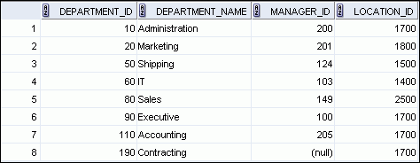
Selecting All Columns
SELECT *
FROM hr.departments;
Notes:
Selecting All Columns
You can display all columns of data in a table by following the SELECT keyword with an asterisk (*). In the example in the slide, the department table contains four columns: DEPARTMENT_ID, DEPARTMENT_NAME, MANAGER_ID, and LOCATION_ID. The table contains eight rows, one for each department.
You can also display all columns in the table by listing all the columns after the SELECT keyword. For example, the following SQL statement (like the example in the slide) displays all columns and all rows of the DEPARTMENTS table:
SELECT department_id, department_name, manager_id, location_id
FROM departments;
Note: In SQL Developer, you can enter your SQL statement in a SQL Worksheet and click the “Execute Statement” icon or press [F9] to execute the statement. The output displayed in the Results tabbed page appears as shown in the slide.

Slide 10
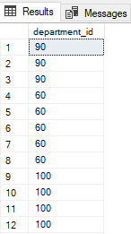
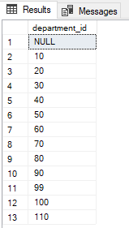
Select Distinct – Duplicate row
SELECT department_id
FROM employees;
SELECT DISTINCT department_id
FROM employees;
1
2
…
…
Notes:
The first example displays the names and the commission percentages of all the employees. Note that the optional AS keyword has been used before the column alias name. The result of the query is the same whether the AS keyword is used or not. Also, note that the SQL statement has the column aliases, name and comm, in lowercase, whereas the result of the query displays the column headings in uppercase. As mentioned in the preceding slide, column headings appear in uppercase by default.
The second example displays the last names and annual salaries of all the employees. Because Annual Salary contains a space, it has been enclosed in double quotation marks. Note that the column heading in the output is exactly the same as the column alias.

Slide 11
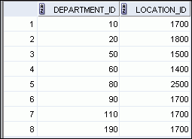
Selecting Specific Columns
SELECT department_id, location_id
FROM hr.departments;
Notes:
Selecting Specific Columns
You can use the SELECT statement to display specific columns of the table by specifying the column names, separated by commas. The example in the slide displays all the department numbers and location numbers from the DEPARTMENTS table.
In the SELECT clause, specify the columns that you want in the order in which you want them to appear in the output. For example, to display location before department number (from left to right), you use the following statement:
SELECT location_id, department_id
FROM departments;
…

Slide 12
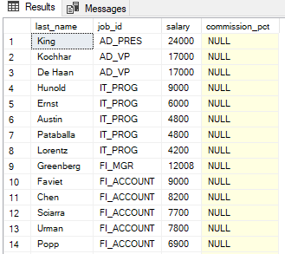
Null Value
SELECT last_name, job_id, salary, commission_pct
FROM hr.employees;
Notes:
If a row lacks a data value for a particular column, that value is said to be null or to contain a null.
Null is a value that is unavailable, unassigned, unknown, or inapplicable. Null is not the same as zero or a blank space. Zero is a number and blank space is a character.
Columns of any data type can contain nulls. However, some constraints (NOT NULL and PRIMARY KEY) prevent nulls from being used in the column.
In the COMMISSION_PCT column in the EMPLOYEES table, notice that only a sales manager or sales representative can earn a commission. Other employees are not entitled to earn commissions. A null represents that fact.

Slide 13
Arithmetic Expressions
Create expressions with number and date data by using arithmetic operators.
Operator
Description
  +
Add
  -
Subtract
*
Multiply
  /
Divide
Notes:
Arithmetic Expressions
You may need to modify the way in which data is displayed, or you may want to perform calculations, or look at what-if scenarios. All these are possible using arithmetic expressions. An arithmetic expression can contain column names, constant numeric values, and the arithmetic operators.
Arithmetic Operators
The slide lists the arithmetic operators that are available in SQL. You can use arithmetic operators in any clause of a SQL statement (except the FROM clause).
Note: With the DATE and TIMESTAMP data types, you can use the addition and subtraction operators only.

Slide 14
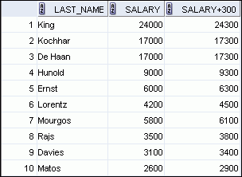
Using Arithmetic Operators
SELECT last_name, salary, salary + 300
FROM hr.employees;
…
Notes:
Using Arithmetic Operators
The example in the slide uses the addition operator to calculate a salary increase of $300 for all employees. The slide also displays a SALARY+300 column in the output.
Note that the resultant calculated column, SALARY+300, is not a new column in the EMPLOYEES table; it is for display only. By default, the name of a new column comes from the calculation that generated it—in this case, salary+300.
Note: The Oracle server ignores blank spaces before and after the arithmetic operator.
Operator Precedence
If an arithmetic expression contains more than one operator, multiplication and division are evaluated first. If operators in an expression are of the same priority, then evaluation is done from left to right.
You can use parentheses to force the expression that is enclosed by the parentheses to be evaluated first.
Rules of Precedence:
Multiplication and division occur before addition and subtraction.
Operators of the same priority are evaluated from left to right.
Parentheses are used to override the default precedence or to clarify the statement.

Slide 15


Operator Precedence
SELECT last_name, salary, 12*salary+100
FROM hr.employees;
1
…
SELECT last_name, salary, 12*(salary+100)
FROM hr.employees;
2
…
Notes:
Operator Precedence (continued)
The first example in the slide displays the last name, salary, and annual compensation of employees. It calculates the annual compensation by multiplying the monthly salary with 12, plus a one-time bonus of $100. Note that multiplication is performed before addition.
Note: Use parentheses to reinforce the standard order of precedence and to improve clarity. For example, the expression in the slide can be written as (12*salary)+100 with no change in the result.
Using Parentheses
You can override the rules of precedence by using parentheses to specify the desired order in which the operators are to be executed.
The second example in the slide displays the last name, salary, and annual compensation of employees. It calculates the annual compensation as follows: adding a monthly bonus of $100 to the monthly salary, and then multiplying that subtotal with 12. Because of the parentheses, addition takes priority over multiplication.

Slide 16
Column Alias
  Renames a column heading
  Is useful with calculations
  Immediately follows the column name (There can also be the optional AS keyword between the column name and the alias.)
  Requires double quotation marks if it contains spaces or special characters, or if it is case-sensitive
Notes:
When displaying the result of a query, SQL Developer normally uses the name of the selected column as the column heading. This heading may not be descriptive and, therefore, may be difficult to understand. You can change a column heading by using a column alias.Specify the alias after the column in the SELECT list using blank space as a separator. By default, alias headings appear in uppercase. If the alias contains spaces or special characters (such as # or $), or if it is case-sensitive, enclose the alias in double quotation marks ("").

Slide 17
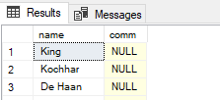
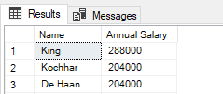
Column Alias
SELECT last_name AS name, commission_pct comm
FROM hr.employees;
1
…
SELECT last_name "Name" , salary*12 "Annual Salary"
FROM hr.employees;
2
…
Notes:
The first example displays the names and the commission percentages of all the employees. Note that the optional AS keyword has been used before the column alias name. The result of the query is the same whether the AS keyword is used or not. Also, note that the SQL statement has the column aliases, name and comm, in lowercase, whereas the result of the query displays the column headings in uppercase. As mentioned in the preceding slide, column headings appear in uppercase by default.
The second example displays the last names and annual salaries of all the employees. Because Annual Salary contains a space, it has been enclosed in double quotation marks. Note that the column heading in the output is exactly the same as the column alias.

Slide 18
QUEST 1
DARI TABEL HR.EMPLOYEES, TAMPILKAN:
SELURUH DATA DALAM TABEL
(gunakan select all)
DAFTAR SEMUA JABATAN PEGAWAI
(kolom job_id, gunakan select distinct)
DATA BERSIH NAMA DEPAN, NAMA BELAKANG, JABATAN, DAN GAJI PER TAHUN
(gunakan select ke kolom spesifik + alias per kolom + fungsi aritmatika)

Slide 19
Restricting Data
WHERE Clause

Slide 20
- Restricting Data

Slide 21
SQL Query Order of Execution
JOIN + FROM
Chose and join tables to get data
WHERE
Filter the data
GROUP BY
Aggregate the base data
HAVING
Filter the aggregated data
SELECT
Returns final data
ORDER BY
Sorts the final data
TOP
Limit the returned data to a row count

Slide 22
Limiting the Rows that Are Selected
  Restrict the rows that are returned by using the WHERE clause:
  The WHERE clause follows the FROM clause.
SELECT *|{[DISTINCT] column|expression [alias],...}
FROM table
[WHERE condition(s)];
Notes:
Limiting the Rows that Are Selected
You can restrict the rows that are returned from the query by using the WHERE clause. A WHERE clause contains a condition that must be met and it directly follows the FROM clause. If the condition is true, the row meeting the condition is returned.
In the syntax:
WHERE restricts the query to rows that meet a condition
condition is composed of column names, expressions, constants, and a comparison operator. A condition specifies a
combination of one or more expressions and logical (Boolean)
operators, and returns a value of TRUE, FALSE, or UNKNOWN.
The WHERE clause can compare values in columns, literal, arithmetic expressions, or functions. It consists of three elements:
Column name
Comparison condition
Column name, constant, or list of values

Slide 23

Using the WHERE Clause
SELECT employee_id, last_name, job_id, department_id
FROM hr.employees
WHERE department_id = 90 ;
Notes:
Using the WHERE Clause
In the example, the SELECT statement retrieves the employee ID, last name, job ID, and department number of all employees who are in department 90.
Note: You cannot use column alias in the WHERE clause.

Slide 24
Character Strings and Dates
  Character strings and date values are enclosed with single quotation marks.
  Character values are case-sensitive and date values are format-sensitive.
  The default date display format is DD-MON-RR.
SELECT last_name, job_id, department_id
FROM hr.employees
WHERE last_name = 'Whalen' ;
SELECT last_name
FROM hr.employees
WHERE hire_date = '17-FEB-96' ;
Notes:
Character Strings and Dates
Character strings and dates in the WHERE clause must be enclosed with single quotation marks (''). Number constants, however, should not be enclosed with single quotation marks.
All character searches are case-sensitive. In the following example, no rows are returned because the EMPLOYEES table stores all the last names in mixed case:
SELECT last_name, job_id, department_id
FROM employees
WHERE last_name = 'WHALEN';
Oracle databases store dates in an internal numeric format, representing the century, year, month, day, hours, minutes, and seconds. The default date display is in the DD-MON-RR format.
Note: For details about the RR format and about changing the default date format, see the lesson titled “Using Single-Row Functions to Customize Output.” Also, you learn about the use of single-row functions such as UPPER and LOWER to override the case sensitivity in the same lesson.

Slide 25
Comparison Operators
Operator
Meaning
  =
Equal to
  >
Greater than
>=
Greater than or equal to
  <
Less than
  <=
Less than or equal to
  <>
Not equal to
BETWEEN
...AND...
Between two values (inclusive)
IN(set)
Match any of a list of values
LIKE
Match a character pattern
IS NULL
Is a null value
Notes:
Comparison Operators
Comparison operators are used in conditions that compare one expression to another value or expression. They are used in the WHERE clause in the following format:
Syntax
... WHERE expr operator value
Example
... WHERE hire_date = '01-JAN-95'
... WHERE salary >= 6000
... WHERE last_name = 'Smith'
An alias cannot be used in the WHERE clause.
Note: The symbols != and ^= can also represent the not equal to condition.

Slide 26

Using Comparison Operators
SELECT last_name, salary
FROM hr.employees
WHERE salary <= 3000 ;
Notes:
Using Comparison Operators
In the example, the SELECT statement retrieves the last name and salary from the EMPLOYEES table for any employee whose salary is less than or equal to $3,000. Note that there is an explicit value supplied to the WHERE clause. The explicit value of 3000 is compared to the salary value in the SALARY column of the EMPLOYEES table.

Slide 27
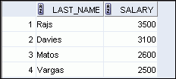
Range Conditions Using the BETWEEN Operator
Use the BETWEEN operator to display rows based on a range of values:
SELECT last_name, salary
FROM hr.employees
WHERE salary BETWEEN 2500 AND 3500 ;
Lower limit
Upper limit
Notes:
Range Conditions Using the BETWEEN Operator
You can display rows based on a range of values using the BETWEEN operator. The range that you specify contains a lower limit and an upper limit.
The SELECT statement in the slide returns rows from the EMPLOYEES table for any employee whose salary is between $2,500 and $3,500.
Values that are specified with the BETWEEN operator are inclusive. However, you must specify the lower limit first.
You can also use the BETWEEN operator on character values:
SELECT last_name
FROM employees
WHERE last_name BETWEEN 'King' AND 'Smith';

Slide 28
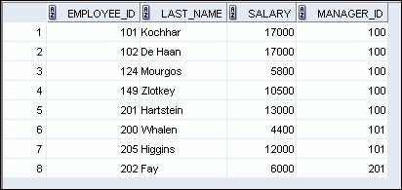
Membership Condition Using the IN Operator
Use the IN operator to test for values in a list:
SELECT employee_id, last_name, salary, manager_id
FROM hr.employees
WHERE manager_id IN (100, 101, 201) ;
Notes:
Membership Condition Using the IN Operator
To test for values in a specified set of values, use the IN operator. The condition defined using the IN operator is also known as the membership condition.
The slide example displays employee numbers, last names, salaries, and managers’ employee numbers for all the employees whose manager’s employee number is 100, 101, or 201.
The IN operator can be used with any data type. The following example returns a row from the EMPLOYEES table, for any employee whose last name is included in the list of names in the WHERE clause:
SELECT employee_id, manager_id, department_id
FROM employees
WHERE last_name IN ('Hartstein', 'Vargas');
If characters or dates are used in the list, they must be enclosed with single quotation marks ('').
Note: The IN operator is internally evaluated by the Oracle server as a set of OR conditions, such as a=value1 or a=value2 or a=value3. Therefore, using the IN operator has no performance benefits and is used only for logical simplicity.

Slide 29
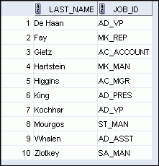
Using the NOT Operator
SELECT last_name, job_id
FROM employees
WHERE job_id
NOT IN ('IT_PROG', 'ST_CLERK', 'SA_REP') ;
Notes:
Using the NOT Operator
The slide example displays the last name and job ID of all employees whose job ID is not IT_PROG, ST_CLERK, or SA_REP.
NOT Truth Table
The following table shows the result of applying the NOT operator to a condition:
Note: The NOT operator can also be used with other SQL operators, such as BETWEEN, LIKE, and NULL.
... WHERE job_id NOT IN ('AC_ACCOUNT', 'AD_VP')
... WHERE salary NOT BETWEEN 10000 AND 15000
... WHERE last_name NOT LIKE '%A%'
... WHERE commission_pct IS NOT NULL

Slide 30
Pattern Matching Using the LIKE Operator
  Use the LIKE operator to perform wildcard searches of valid search string values.
  Search conditions can contain either literal characters or numbers:
    % denotes zero or many characters.
    _ denotes one character.
SELECT first_name
FROM hr.employees
WHERE first_name LIKE 'S%' ;
Notes:
Pattern Matching Using the LIKE Operator
You may not always know the exact value to search for. You can select rows that match a character pattern by using the LIKE operator. The character pattern–matching operation is referred to as a wildcard search. Two symbols can be used to construct the search string.
The SELECT statement in the slide returns the first name from the EMPLOYEES table for any employee whose first name begins with the letter “S.” Note the uppercase “S.” Consequently, names beginning with a lowercase “s” are not returned.
The LIKE operator can be used as a shortcut for some BETWEEN comparisons. The following example displays the last names and hire dates of all employees who joined between January, 1995 and December, 1995:
SELECT last_name, hire_date
FROM employees
WHERE hire_date LIKE '%95';

Slide 31
QUEST 2
CARI PEGAWAI YANG PUNYA FIRST_NAME HURUF DEPANNYA L
LIHAT ADA BERAPA ORANG

Slide 32

Using the NULL Conditions
Test for nulls with the IS NULL operator.
SELECT last_name, manager_id
FROM employees
WHERE manager_id IS NULL ;
Notes:
Using the NULL Conditions
The NULL conditions include the IS NULL condition and the IS NOT NULL condition.
The IS NULL condition tests for nulls. A null value means that the value is unavailable, unassigned, unknown, or inapplicable. Therefore, you cannot test with =, because a null cannot be equal or unequal to any value. The slide example retrieves the last names and managers of all employees who do not have a manager.
Here is another example: To display the last name, job ID, and commission for all employees who are not entitled to receive a commission, use the following SQL statement:
SELECT last_name, job_id, commission_pct
FROM employees
WHERE commission_pct IS NULL;
…

Slide 33
Defining Conditions Using the Logical Operators
Operator
Meaning
  AND
Returns TRUE if both component conditions are true
  OR
Returns TRUE if either component condition is true
NOT
Returns TRUE if the condition is false
Notes:
Defining Conditions Using the Logical Operators
A logical condition combines the result of two component conditions to produce a single result based on those conditions or it inverts the result of a single condition. A row is returned only if the overall result of the condition is true.
Three logical operators are available in SQL:
AND
OR
NOT
All the examples so far have specified only one condition in the WHERE clause. You can use several conditions in a single WHERE clause using the AND and OR operators.

Slide 34

Using the AND Operator
AND requires both the component conditions to be true:
SELECT employee_id, last_name, job_id, salary
FROM employees
WHERE salary >= 10000
AND job_id LIKE '%MAN%' ;
Notes:
Using the AND Operator
In the example, both the component conditions must be true for any record to be selected. Therefore, only those employees who have a job title that contains the string ‘MAN’ and earn $10,000 or more are selected.
All character searches are case-sensitive, that is no rows are returned if ‘MAN’ is not uppercase. Further, character strings must be enclosed with quotation marks.
AND Truth Table
The following table shows the results of combining two expressions with AND:

Slide 35
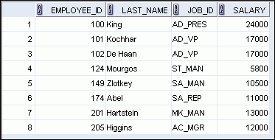
Using the OR Operator
OR requires either component condition to be true:
SELECT employee_id, last_name, job_id, salary
FROM employees
WHERE salary >= 10000
OR job_id LIKE '%MAN%' ;
Notes:
Using the OR Operator
In the example, either component condition can be true for any record to be selected. Therefore, any employee who has a job ID that contains the string ‘MAN’ or earns $10,000 or more is selected.
OR Truth Table
The following table shows the results of combining two expressions with OR:

Slide 36
Quest 3!
Siapakah pegawai yang tidak mempunyai manager?
Karen Colmenares
Steven King
Lex De Haan
Guy Himuro

Slide 37
Ordering Data
ORDER CLAUSE

Slide 38
SQL Query Order of Execution
JOIN + FROM
Chose and join tables to get data
WHERE
Filter the data
GROUP BY
Aggregate the base data
HAVING
Filter the aggregated data
SELECT
Returns final data
ORDER BY
Sorts the final data
TOP
Limit the returned data to a row count

Slide 39
- Limiting Aggregated Data

Slide 40
ORDER BY
Sorting Data
Mengurutkan data menggunakan ORDER BY:
ASC: Ascending order, default
DESC: Descending order
Contoh:
SELECT last_name, job_id, department_id, hire_date
FROM employees
ORDER BY hire_date ASC;
Mengurutkan berdasarkan kolom hire_date dengan urutan ascending
SELECT employee_id, last_name, salary*12 annsal
FROM employees
ORDER BY annsal ;
Mengurutkan berdasarkan nama alias annsal
SELECT last_name, department_id, salary
FROM employees
ORDER BY 2, salary DESC;
Mengurutkan menggunakan beberapa kolom, salah satunya menggunakan posisi dari kolom di SELECT

Slide 41
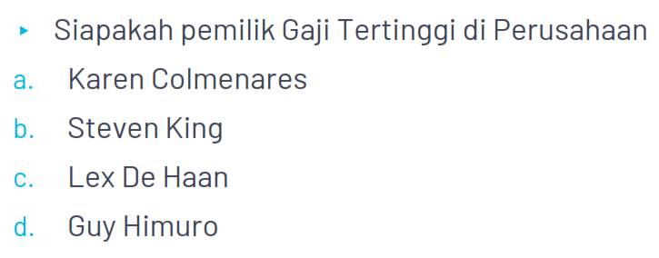
Quest 4

Slide 42
THANKS!

Slide 43
OR Operator
OR | Cond 1 TRUE | Cond 1 FALSE
Cond 2 TRUE | TRUE | TRUE
Cond 2 FALSE | TRUE | FALSE
AND | Cond 1 TRUE | Cond 1 FALSE
Cond 2 TRUE | TRUE | FALSE
Cond 2 FALSE | FALSE | FALSE

